Slide 1


Emergency Operations Center Design and Equipment Considerations
The mark “CDC” is owned by the US Dept. of Health and Human Services and is used with permission..
Use of this logo is not an endorsement by HHS or CDC of any particular product, service, or enterprise.

Slide 2


EOC Design

Slide 3


EOC Physical Infrastructure
An EOC can be housed in a dedicated space, or set up in a multi-purpose space
It must be physically and environmentally secure, as well as accessible and survivable in the event of a threat or disaster
In the event of a technological or other failure, there should be alternate EOC options available, and a chosen back-up physical location should be ready
It must also be easily accessible to personnel, including parking security, and reasonable proximity to designated lead and partner agencies

Slide 4
Facility
The EOC should have enough space to accommodate all personnel
In the COVID-19 environment, it is especially important to have enough space to allow for physical distancing
Have access to common areas and closed workspaces for meetings or conference calls
During COVID-19, prioritize layout to accommodate more frequent video/teleconference calls
Make an external area available for media briefings, interviews, press conferences, and coordination of external partners
Have adequate sanitary facilities, rest areas, and food amenities for all personnel

Slide 5
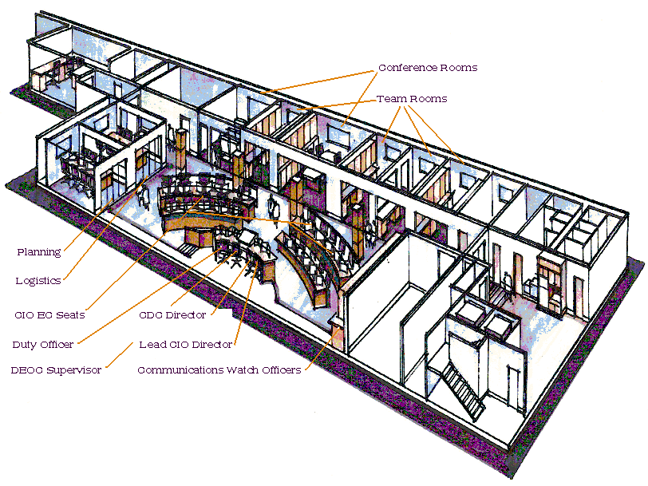
EOC Layout
Communication and eye contact between decision makers
Space for:
Operational Coordination
Decision Making
Collaboration
Communications
Physical Distancing (if required)

Slide 6
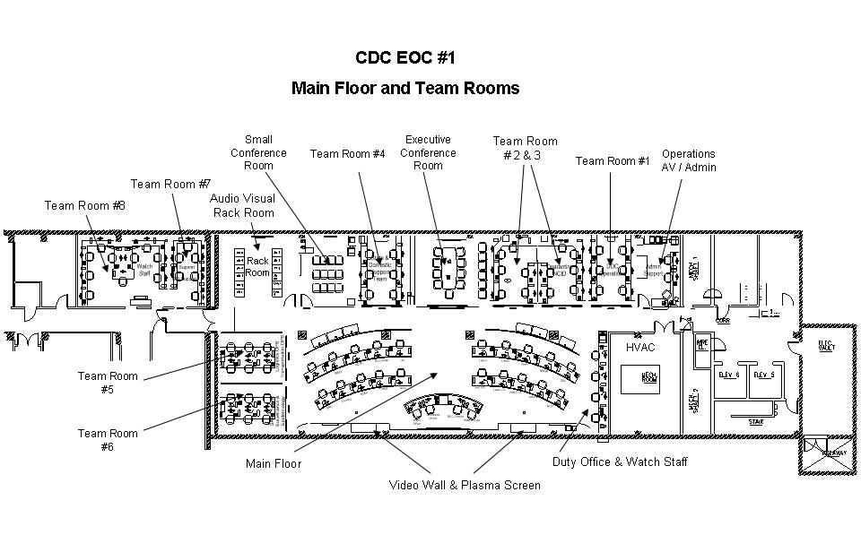
Lead Agency EOC Example #1

Slide 7
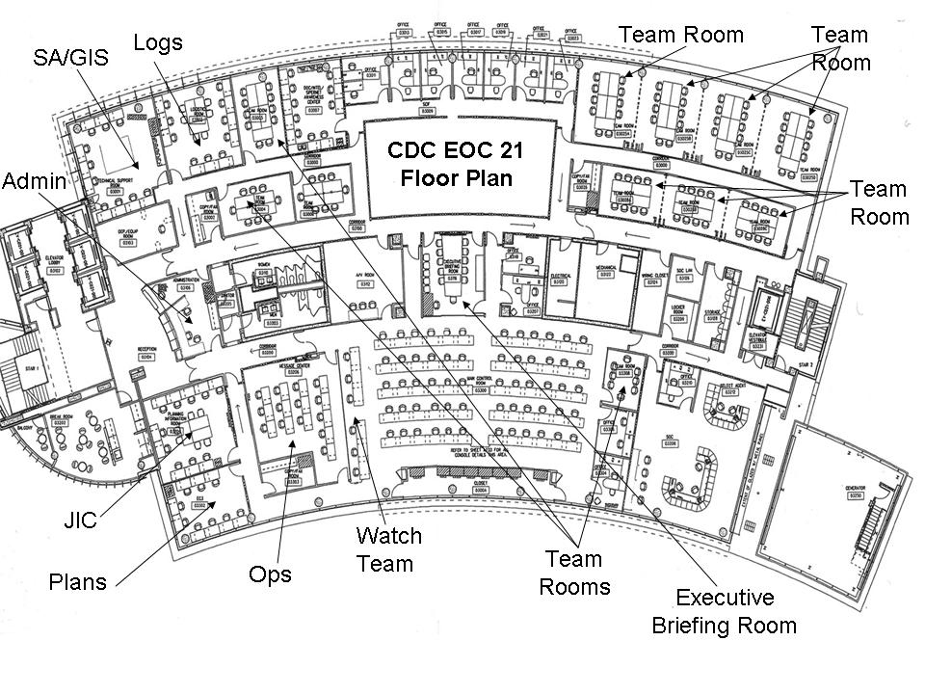
Lead Agency EOC Example #2

Slide 8
Design Considerations
Executive office space
Staff seating
In a COVID-19 environment, this can mean ensuring there is an empty seat between each staff member to adhere to physical distance guidelines
Computers, phones, printers, fax machines
Break-out or meeting rooms for teams
Special use rooms: Press room, communications
Hygiene space
Sleeping quarters
Food service and eating space
Environment: Noise level, air quality

Slide 9
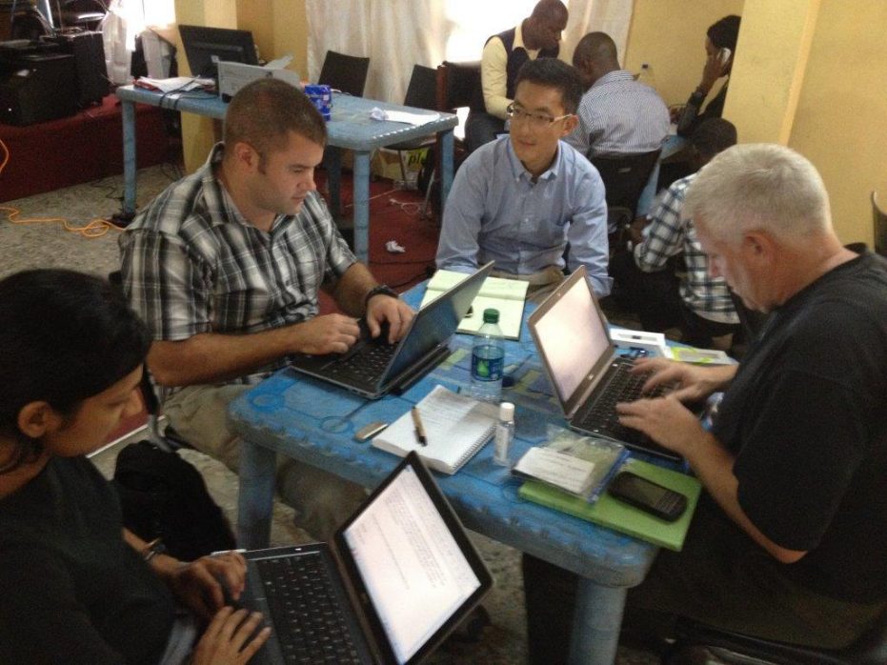
Layouts
CDC/ Sally Ezra, 2014. Nigeria EOC, Lagos, Nigeria.
Jennifer Brooks, 15 August 2014. EOC, Freetown International Airport, Sierra Leone.

Slide 10
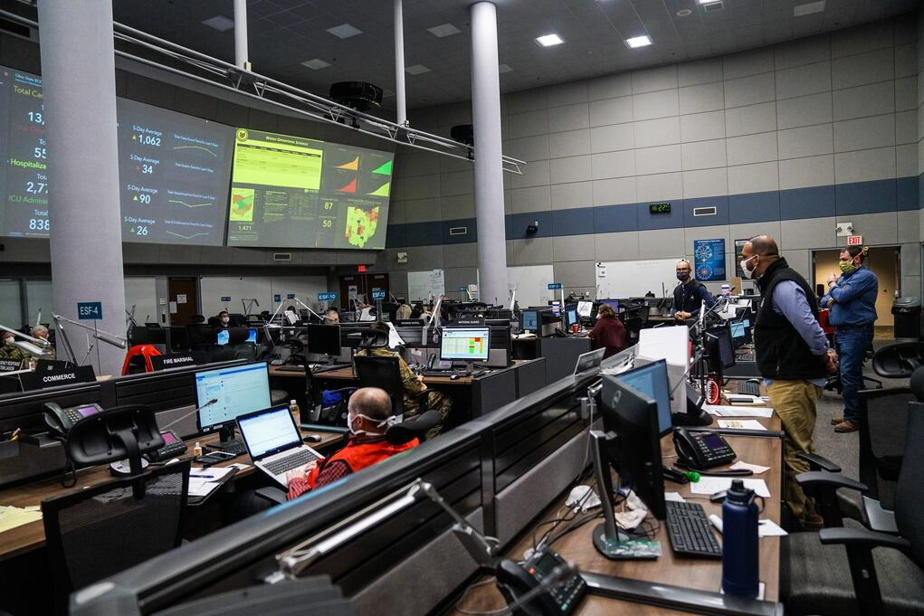
Layouts
Giancarlo Casem/ U.S. Air Force. 12 May 2020.
FEMA/Alexis Hall, 2020. Ohio EOC, Columbus, Ohio.

Slide 11
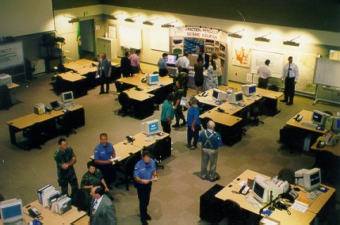

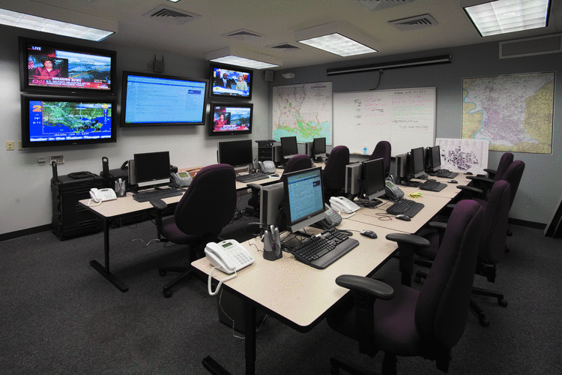
Layouts

Slide 12
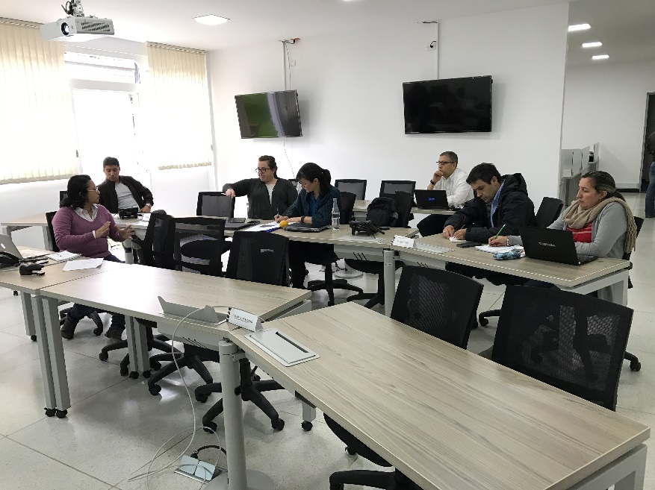
Layouts
Maryland GovPics, 10 August 2016. Howard County EOC, Maryland, USA.
CDC/Jim Banaski, January 2017. Instituto Nacional de Salud EOC, Colombia.

Slide 13
Additional Features - Boardroom
During COVID-19, ensure spacing between chairs complies with physical distancing guidelines.

Slide 14
Additional Features - Mission Control

Slide 15
Additional Features - Market Place

Slide 16
Equipment
The equipment in an EOC should:
Reflect the scope and design of the facility
Be sufficient to support the EOC’s functions
Be optimized for long-term sustainability
Be cleaned/disinfected regularly (especially during COVID-19)
Personnel in the EOC must be trained in the use of equipment as part of their on-boarding as well as through regular refresher training.

Slide 17
Hot, Warm, and Cold Facilities
Hot: Fully equipped, utilities working, shortest EOC activation period required.
Warm: Some systems/equipment in place, moderate EOC activation period required.
Cold: Not equipped, utilities not working, longest EOC activation period required.

Slide 18
EOC Design Considerations
A properly-designed EOC should:
Serve as an effective and efficient facility for coordinating emergency response efforts
Serve a number of uses including operations, training, and meetings
Optimize communication and coordination by effective information management and presentation
Maintain a safe working environment for personnel, including appropriate infection prevention measures

Slide 19
EOC Location
Factors to consider when selecting a facility for the EOC
Accessibility
Safety
Size (particularly to ensure physical distance during COVID-19)
Systems capability
Survivability
Versatility

Slide 20
EOC Equipment

Slide 21
EOC Equipment Considerations
The main function of an Emergency Operations Center is coordination, so ensuring that it is stocked with the necessary equipment and supplies is critical.
In a COVID-19 environment, this can mean additional cleaning supplies and equipment to support physical distancing guidelines.

Slide 22
EOC Equipment Considerations
Auxiliary Power
Generators, uninterrupted power systems, & surge protection
Mechanical
Lighting, backup systems & equipment, flashlights, batteries, & bulbs
Communications
Phones/Cell Phones, Radios (inter-personnel and inter-agency), commercial radios, TV cable and satellite connections
Displays
Maps, charts/displays, projectors with screens, white or chalk boards, electronic boards, bulletin boards, easels with flipcharts/pads, monitors, projectors, etc.
Furniture
Tables/chairs, desks, clocks

Slide 23
EOC Equipment Considerations
Office Equipment (Electric)
Computers, photocopiers, extension cords, surge protectors, etc.
Record Keeping
Recording system & equipment, cameras, message forms, logs, time tracking software
Documents
Plans (extra copies), SOPs, resource staffing lists, & library of reference materials (phone books and resource lists)
Supplies
Pencils, pens, printer paper, printer/copier toner, writing pads, paper clips, tape, push pins, staplers/staples, scissors, name tags, folders, boxes, clipboards, binders, etc.
In a COVID-19 environment, this could mean additional signs and posters reminding staff adhere to physical distancing guidelines

Slide 24
EOC Equipment Considerations
Food Access & Supplies
Food service/storage, kitchen, dining facilities, can openers, coffee, etc.
Sanitary, Hygiene Facilities
Toilets, showers, sanitation kits (chemical disinfectants, commode seats, etc.)
Additional COVID-19 related items may include:
Thermometers, hand sanitizer, testing kits
Gloves, face masks, face shields, and other necessary PPE
Additional cleaning supplies, disinfectants, etc. to sanitize all communal equipment and spaces
Garbage, Trash Supplies
Brooms, sponges, mops, buckets, cleaning supplies, trash cans, shovels.

Slide 25


